Slide 1
PerFectIT
Final Presentation Review
March 21, 2018

Slide 2
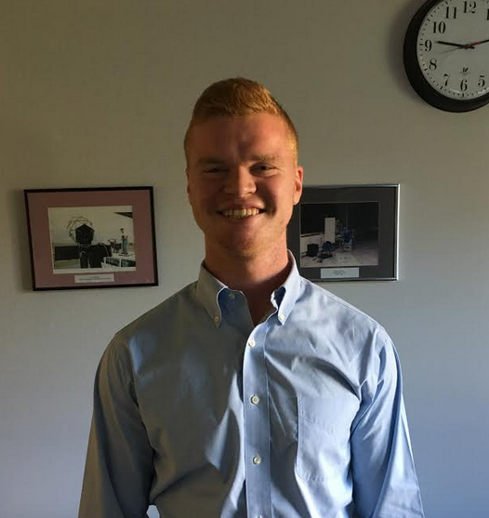
Introducing team members
Sai Yarram
Nick Raymond
Andrew Sjogren
Maxwell Gerhardson

Slide 3
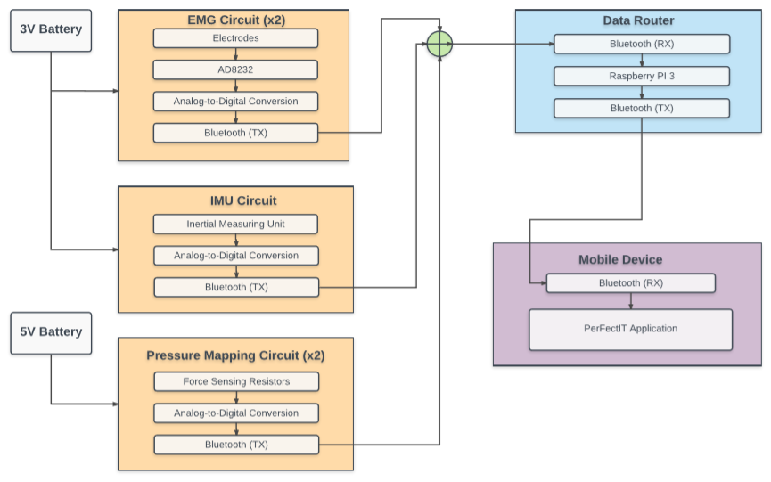
Block Diagram

Slide 4
Individual Responsibilities
Software Team
Sai Yarram
Server and Backend development and Implementation
User Authentication, Data Storage/Retrieval Implementation
UI and Algorithm Development
Nick Raymond
Hardware and Software Integration
Implementation of Bluetooth
Weight calibration analysis with FSR
UI and Algorithm Development
Hardware Team
Andrew Sjogren
Decision between FSR and Piezo Sensors
Implementation of chosen sensor into constructed foot insoles
Testing and calibration of foot insoles
PCB schematic design for foot insoles
Data collection
Maxwell Gerhardson
Design and implement AD8232 for EMG sensing into knee brace
PCB design for EMG sensing circuit
Implement 9DOF razor IMU
Data Collection

Slide 5
Inertial Measuring Unit
Inertial Measuring Unit
SparkFun 9DoF Razor IMU MO
Senses Euler angles:
< time, pitch, roll, yaw >
Communicates data to Raspberry Pi via Bluetooth
Data analytics to be performed on Raspberry Pi

Slide 6
Foot Sensors
Furthest Point of Progress:
Hooked into breadboard
Communicating simultaneous data via Bluetooth to Raspberry Pi
Upon migration to Protoboard, shorting of 3.7 V battery
Could be due to hand soldering overlaps, although none were observed

Slide 7
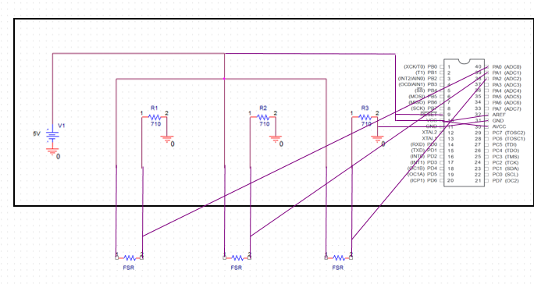
Foot Sensor Schematic (PCB Design)

Slide 8
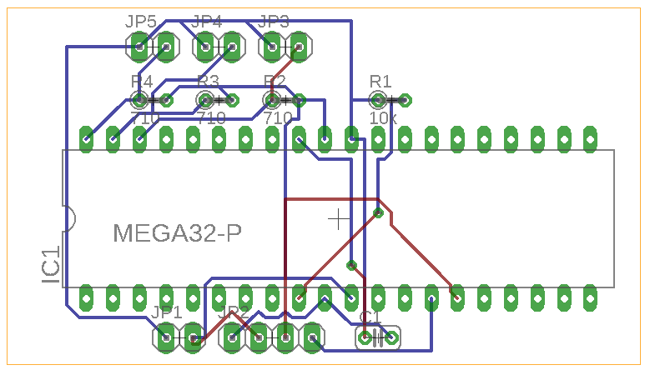
Foot Sensor PCB

Slide 9
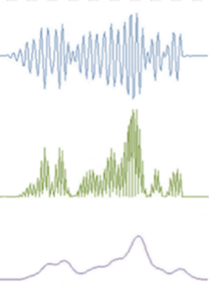
EMG Knee Brace
EMG Sensors
Conductive fabric electrodes
Signal detection
Sewn into knee brace
Analog Devices AD8232
Amplifier (~ 40dB of gain)
Filter (single-pole HPF @ 5Hz)

Slide 10
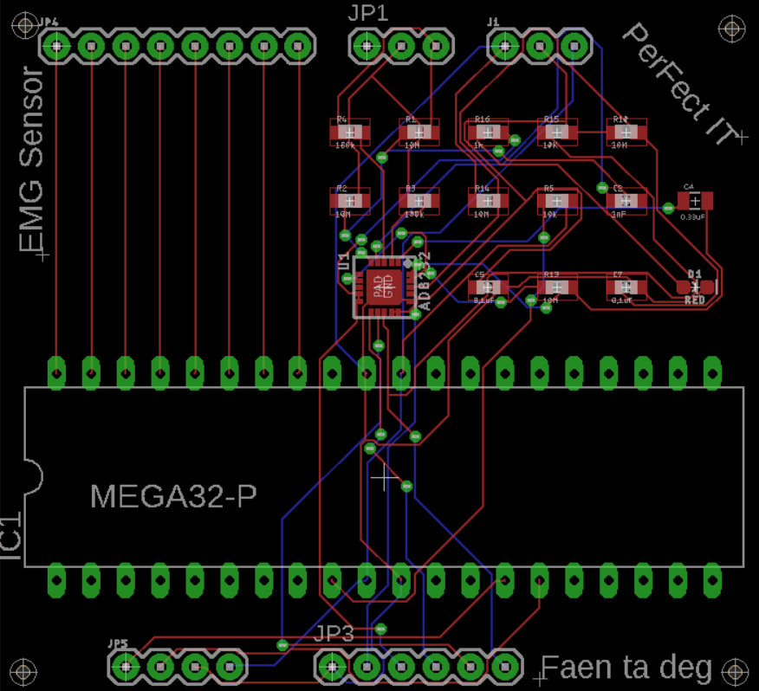
EMG PCB Design

Slide 11
Weight Calibration
-Good Relativity
-Inside of foot takes on more of weight with added load
-Clear weight shift from standing to squatting

Slide 12
Power Budget

Slide 13
Software Design Specifications
Database Storage Options
SQLite
AWS
Firebase
SQLite
Light weight, no network access, relational
AWS
Cloud Service, User Authentication, Cloud Storage
Firebase
Cloud Service, User Authentication, NoSQL, Cloud Storage, Compatible

Slide 14
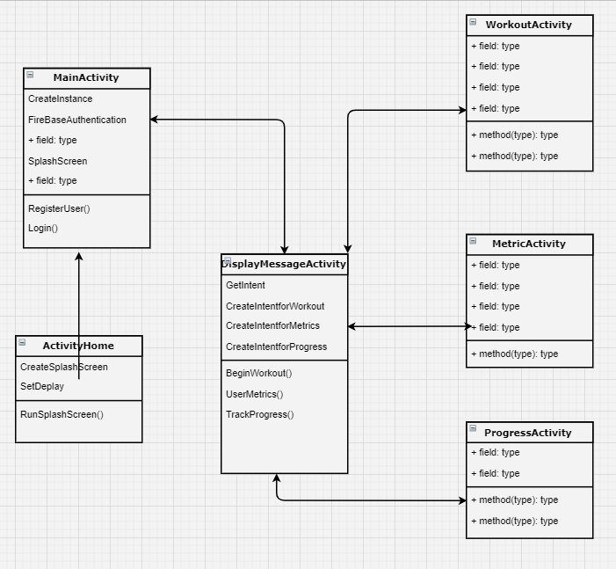
Block Diagram
Splash Screen
Main Activity
Display Message Activity
Branch:
Workout Activity
Metric Activity
Progress Activity

Slide 15
Thank you
Questions?

